Slide 1

BLOCKAGE DETECTION IN DRAINAGE SYSTEM USING FLOW SENSOR
PESENTED BY
EZHIL RAGAVAN A
ABISHEK V
AJAY D
ANGURAJ KARTHIK V

Slide 2
INTRODUCTION
Sewage is nothing by the wastes from the industries, residential area and other buildings in the form of grey water. Sewage consists of solid and liquid wastes that travel from one area to another through sewage tunnels. Mostly sewage tunnels are dig underground and buried inside the earth crust and hence the wastes from the buildings are sent through the sewage tunnels through inclined pipelines.

Slide 3
PROBLEM STATEMENT
Today's drainage system is not computerized. So whenever there is blockage it is difficult to figure out exact location of the blockage. Also we don't get early alerts of the blockage. Hence detection and repairing of the blockage becomes so time consuming. It becomes very inconvenient to handle the situation when pipes are blocked completely. due to such failure of drainage line people face a lot of problems.

Slide 4
OBJECTIVE
Drainage conditions should be monitored in order to maintain its proper function. In fact, not all areas have drainage monitoring team. It leads to irregular monitoring of the drainage condition. The irregular monitoring has contribution on the clogging of the drainage that imply to the siltation which trigger flooding in the neighborhood. Manual monitoring is also inefficient. It needs a lot of dedicated persons who are only able to record limited report with low accuracy. These weaknesses lead to the slow handling for problems in drainage.

Slide 5
EXISTING SYSTEM
In the existing system, the sewage blocks are determined manually and hence it is the time consuming process and within the block identification and rectification process, the sewage spills all over the man hole areas and hence there exists the high risk of disease spread due to contamination.

Slide 6
PROPOSED SYSTEM
The flow sensor sense the flow and gives some monitored parameters to the ESP8266.The monitoring parameters are nothing but the flow of water through the drainage pipe lines. This system is expected to monitor the drainage conditions real time continuously. If the flow is decreases it is alert that the flow is decreases ,then we can come to know that there is a blockage.

Slide 7
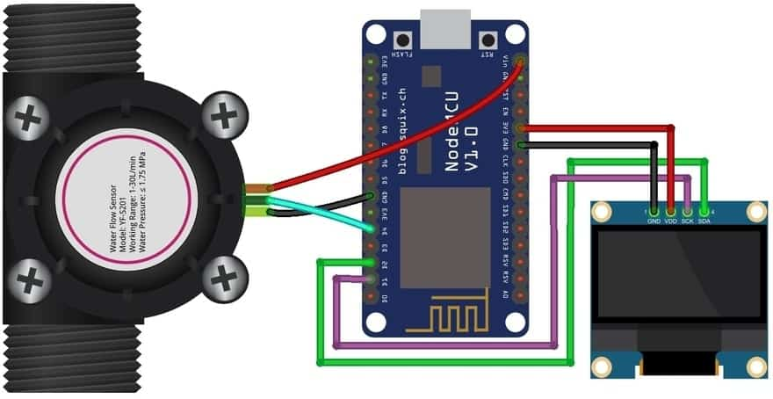
CIRCUIT DIAGRAM

Slide 8
METHODOLOGY
COMPONENTS USED ;
There are some hardware used. The hardware components are,
Water flow sensor,
Esp8266,
OLED display.

Slide 9
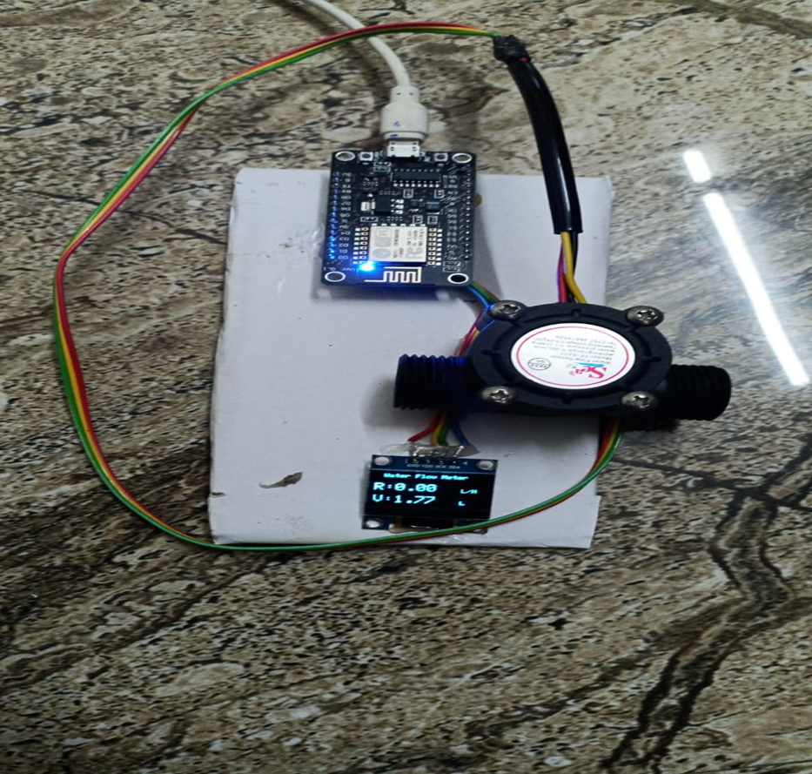
MODEL KIT

Slide 10
COMPARISON
Easy process
Safer to work with
To locate the accurate location
computerised

Slide 11
CONCLUSION
By using our creation, we can sense the flow of water in a pipe line if there is any blockage in the pipe line definitely the flow of water will decrease, the decreased flow of water is sensed by the flow sensor and it gives some parameters to the ESP8266. The ESP8266 is programmable to alert if the flow is decreased. The ESP8266 is connected with a OLED display which displays the rate of the flow of water and volume of the water.

Slide 12
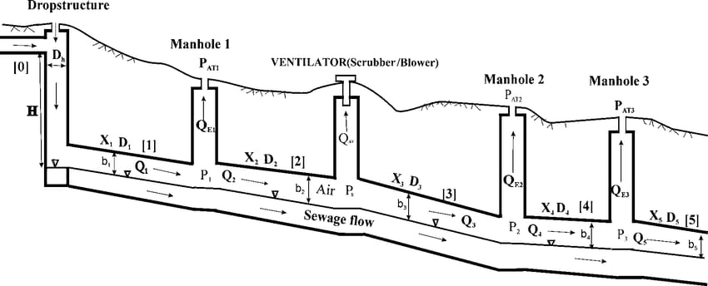

Slide 13
Thank You !!!

